Slide 1
Statistical analysis of ECG signal for mycardial ischaemia and build solution to classify ECG
Group Members:
Madhurima Purkait
Pratyusha Sinha
Subrata Sarkar
Sneha Tiwari

Slide 2
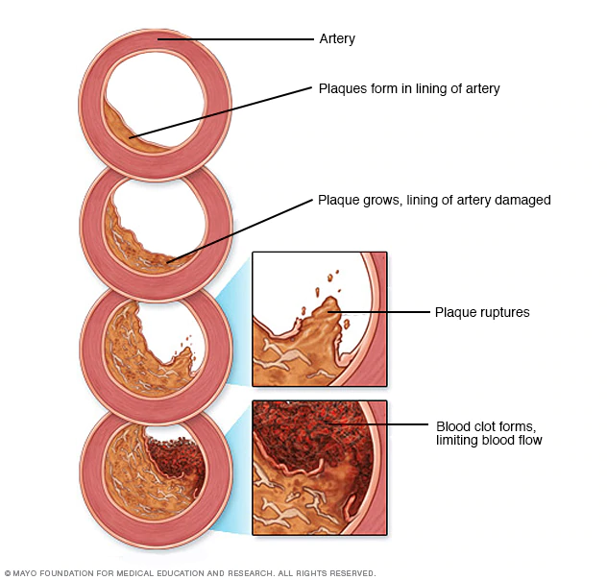
Introduction:
Myocardial ischemia occurs when blood flow to the heart is reduced, preventing the heart muscle from receiving enough oxygen. The reduced blood flow is usually the result of a partial or complete blockage of the heart's arteries (coronary arteries).
Myocardial ischemia, also called cardiac ischemia, reduces the heart muscle's ability to pump blood. A sudden, severe blockage of one of the heart's artery can lead to a heart attack. Myocardial ischemia might also cause serious abnormal heart rhythms.
Symptoms:
Some people who have myocardial ischemia don't have any signs or symptoms (silent ischemia).
Signs and symptoms which might be experienced :
chest pressure or pain(typically on the left side of the body)
Neck or jaw pain
Shoulder or arm pain
A fast heartbeat
Shortness of breath when you are physically active
Nausea and vomiting
Sweating
Fatigue
Causes: Conditions that can cause myocardial ischemia include:
Coronary artery disease (atherosclerosis). Plaques made up mostly of cholesterol build up on your artery walls and restrict blood flow.

Slide 3
Blood clot. The plaques that develop in atherosclerosis can rupture, causing a blood clot.
Coronary artery spasm(Uncommon Cause). This temporary tightening of the muscles in the artery wall can briefly decrease or even prevent blood flow to part of the heart muscle.
Chest pain associated with myocardial ischemia can be triggered by:
1.Physical exertion 2.Emotional stress 3.Cold temperatures 4.Cocaine use 5.Eating a heavy or large meal
6.Sexual intercourse
Risk factors:
1.Tobacco 2.Diabetes 3.High blood pressure 4.High blood cholesterol level 5.High blood triglyceride level 6.Obesity Waist circumference 7.Lack of physical activity
Complications:
Heart attack
Irregular heart rhythm (arrhythmia)
Heart failure
Treatment:
Treatment for myocardial ischemia involves improving blood flow to the heart muscle. Treatment may include medications, a procedure to open blocked arteries (angioplasty) or bypass surgery.

Slide 4
Electrocardiogram (ECG):
Our nerve and muscle cells communicate with each other using electrical and chemical signals. Regular electrical signals also control our heartbeat. These signals are sent by a group of cells in the right atrium of the heart known as the sinoatrial node (SA node), and they spread through the heart muscle tissue as tiny electrical impulses. This causes first the atria and then the ventricles of the heart to contract. The way that these signals spread through the heart can also be measured on the surface of our skin. An ECG measures these changes in electrical signals (or, in fact, voltage) on different areas of skin and plots them as a graph. The resulting ECG graph is called an electrocardiogram.
It mainly records how often the heart beats (heart rate) and how regularly it beats (heart rhythm).
The ECG Test Involves:
The electrical activity of the heart can be measured on the surface of the skin – even as far from the heart as on the arms or legs. The standard “12-lead ECG” uses a total of ten electrodes: six on your chest, and then one each on the lower arms and calves.
Types of ECG tests:
Resting ECG: This involves lying still on your back with a bare chest.
Exercise ECG: Here the electrical activity of your heart is measured while you are physically active.
Holter monitor: The electrical activity of the heart is typically recorded over a period of 24 hours. Three or four electrodes are attached to your chest, and a small recording device is worn on a belt or hung around your neck.
The results of a 12-lead ECG show:
The 12-lead ECG takes advantage of the fact that signals sent by the heart don't travel evenly over the skin. The device compares the strength of the signals between two electrodes called “leads.”

Slide 5
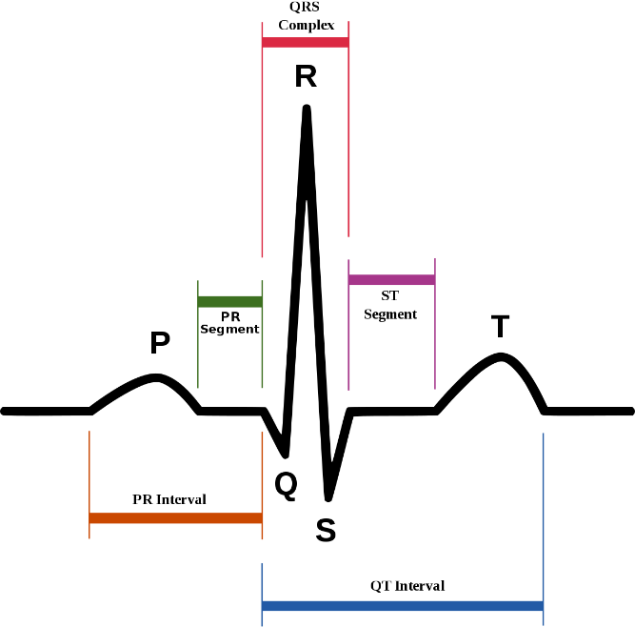
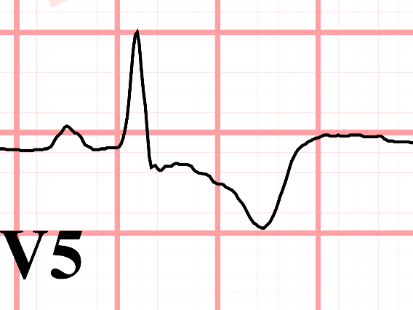
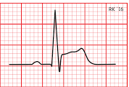
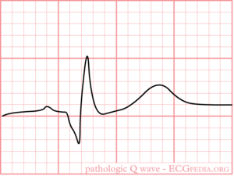
For example, one of the leads is measured based on the two electrodes on your arms. A 12-lead ECG, as its name implies, is used to measure twelve leads. Depending on which lead shows irregularities, experts can find out things like in which part of the heart muscle an infarction has occurred, or whether a heart rhythm problem is coming from the left or right ventricle.
In Myocardial Infraction changes in ECG are:
ST segment elevation.
T wave inversion
Appearance of wide deep Q waves.
T wave inversion
ST Segment Elevation
Wide deep Q waves
Normal ECG
Abnormal ECG

Slide 6
Previous Work
https://www.banglajol.info/index.php/BJMP/article/download/39147/26626
https://link.springer.com/article/10.1007/s10489-018-1179-1

Slide 7
Myocardial Ischemia Detection from Slope of ECG ST Segment
Our main aim is to develop a program/code to detect myocardial
Ischemia with the help of ECG report,which would be computationally less complex and easy to implement in homecare ECG devices.
It has been observed that for the normal case, the ST segment(in pqrs complex)is at approximately the same level as the isoelectric line. However, it is found that for ischemia, the ST segments are clearly elevated with respect to the isoelectric level .
So, the proposed method measures slope of ST segment which must vary in case of ST changes.
We are using the European ST-T database ehich contains ECG signals with ST segment and T wave changes (Taddei, et al., 1992). The database contains ECG signals from ischemic patients where normal ECG sections and sudden ischemic episodes are annotated.

Slide 8
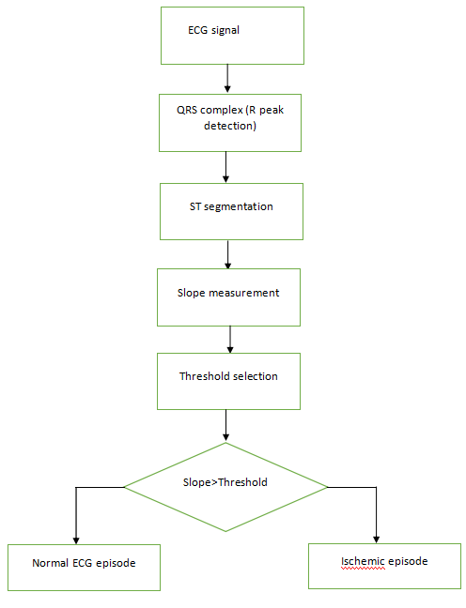
Steps to be followed for the detection of ST segment
QRS complex detection(R peak detection).
Finding of ST segment or ST segment detection.
Slope measurement.
Thresholding
Result and analysis.

Slide 9
ST segmentation
The duration of ST segment is usually 120ms.
The ECG signals used have a sampling frequency of 250 Hz. So the length equals to approximately 30 samples.
Experimentally it is observed that the ST segment starts at about 15 samples after the R peak. So the 30 samples of ST segment is extracted accordingly.

Slide 10
Algorithm for ST segment detection.
Step1: Start
Step 2: Locate the R Peak.
Step 3: Take the 15th sample after the R peak.
Step 4: Take approximately 30 sample after the 15th sample.
Step 5: Save these 30 sample as ST segment.
Step 6: End

Slide 11

Slope measurement
When elevation of ST segment is higher than 0.1 mV, it is called ST elevation.
In normal condition, the ST segment seldom elevates. If the ST segment is elevated, then the slope the ST segment creates with the isoelectric line will vary.
For a single ST segment, if A and B are the values of the last and first sample respectively, C is the number of samples in the ST segment then the slope can be defined as,
tan 𝜃 = 𝐴 − 𝐵/C
Similarly, slope of each ST segment of a portion of ECG signal is calculated and averaged to get an overall trend.
Thresholding: The thresholding of slope value to classify a portion of ECG as ischemic episode or normal ECG episode is done experimentally.

Slide 12
Result and Analysis
The target of the proposed work is to examine whether slopes of ST segments of ischemic episode and normal ECG episode cluster in different groups.
The table below contains detailed information of the ECG signals used. From each of the five patient records episodes of normal ECG and ischemia is taken. Also the average slope of all the ST segments in that particular episode of ECG is calculated.
For finding a threshold value we have separated the classes into two, one for normal patient and another for ischemic patients.
Then the slope values of normal ECG episodes are sorted in ascending order and ischemic episodes in descending order. The tablebelow shows the sorted values of both the patient.

Slide 13
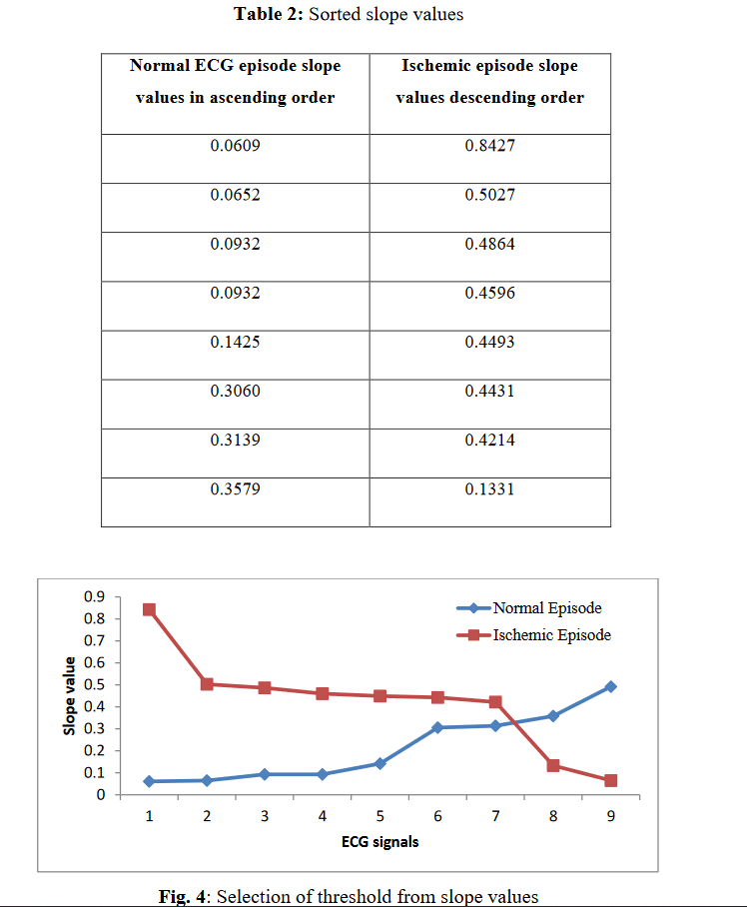
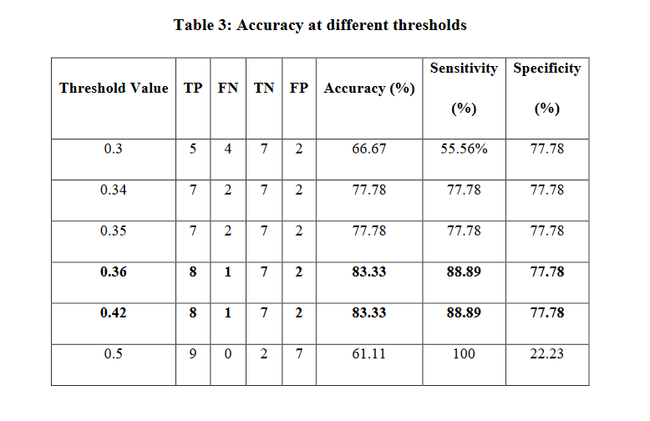
From the table, it can be observed that the two series intersects at around 0.34. So if a threshold is selected based on it then any value over 0.34 would be a detected as an ischemic episode.

Slide 14
Our solution
We want to analyze the ECG data to provide a prediction about the ECG whether the patient has myocardial ischaemia.
In order to do that we need to perform statistical analysis of the ECG signals for different paitents
We have built functions to find slope for various segments in the slices of the ECG. We not only measure the slope but also the area for the QRS segment and the angle made by the R peak
Two methods of prediction that we have in our consideration are ,one using the ST segment slope and the other to use a 1d convolutional neural network to classify the ECG

Slide 15
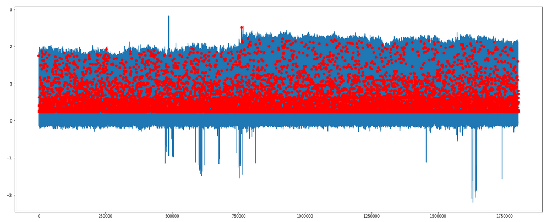
R peak detection using max by slicing every 200 points

Slide 16
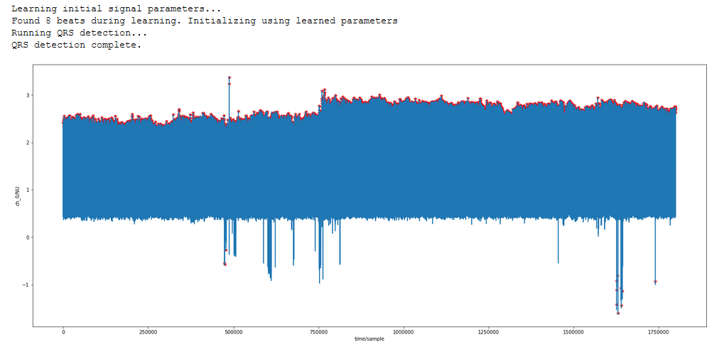
R peak detection using XQRS detection

Slide 17
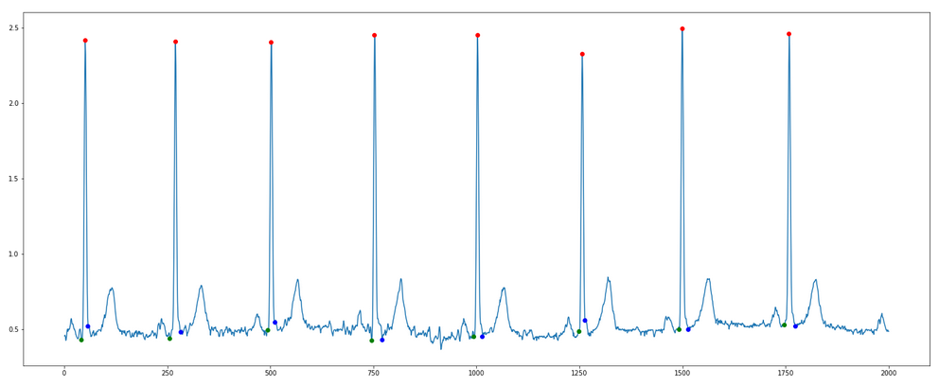
QRS segment detection

Slide 18
Work done till now
We have so far built functions which takes slice of ECG with 8 R-peaks as input and detects the R-peaks using XQRS detection provided with wfdb module.
First we tried to detect the R-peaks by slicing the ECG using the fact that on average a single heart beat takes 0.8 sec and finding the max voltage in the slice, but we found the method to fail incase the R-peak was not present in the slice so we switched to XQRS algorithm.
We found out that in our dataset that the S-T segment lied between the R peak+15 time slice and R peak+45 time slice. Also Q and S point detection was easy as we needed to find the point of deflection tothe left and right of the R peak respectively

Slide 19
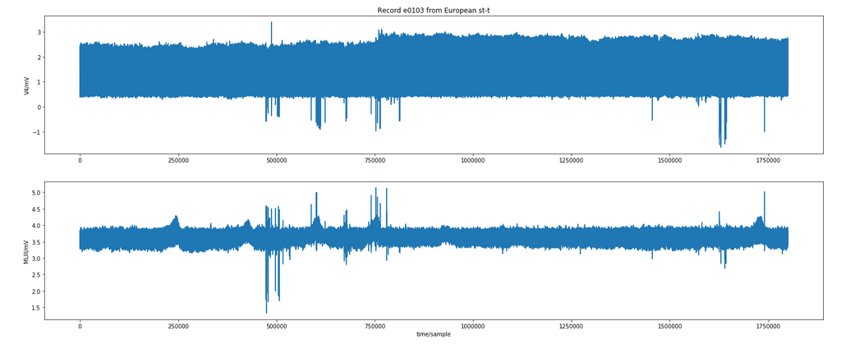
Sample ECG from dataset

Slide 20
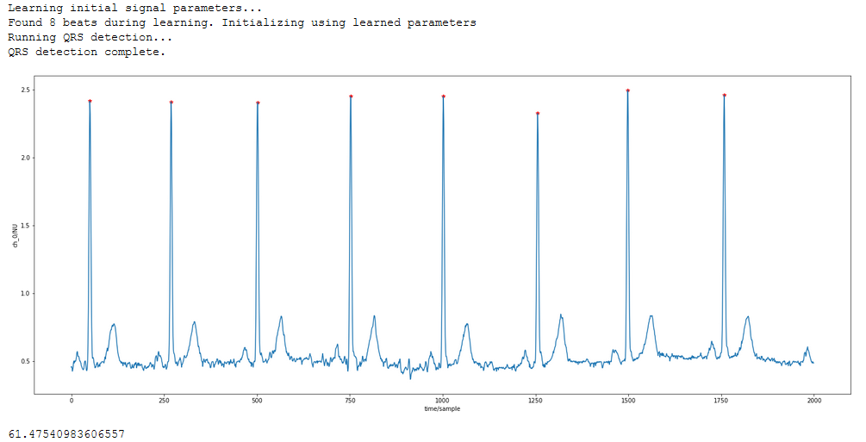
R peak detection using XQRS small slice

Slide 21
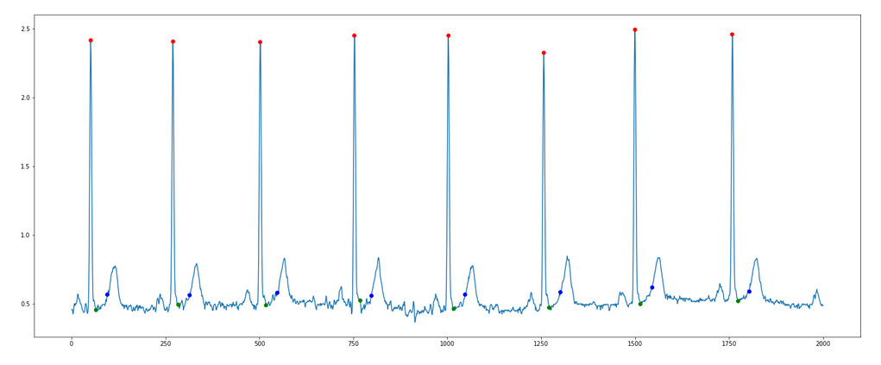
ST segment detection

Slide 22
How we can proceed further from this step
As we found out in the paper published by University of Dhaka we intend to use ST slope for our primary classification and then use the other slope data as secondary condition for the classification
We also found out that instead of using the images of ECG we can also use 1d Convolutional Neural Network to feed the raw series and perform classification. (Source: https://www.sciencedirect.com/science/article/pii/S2352914818301333). We intend to develop our own CNN model and perform classification
Then we want to compare these two methods and implement the better model as a software which doctors and techicians can use in real world.

Slide 23
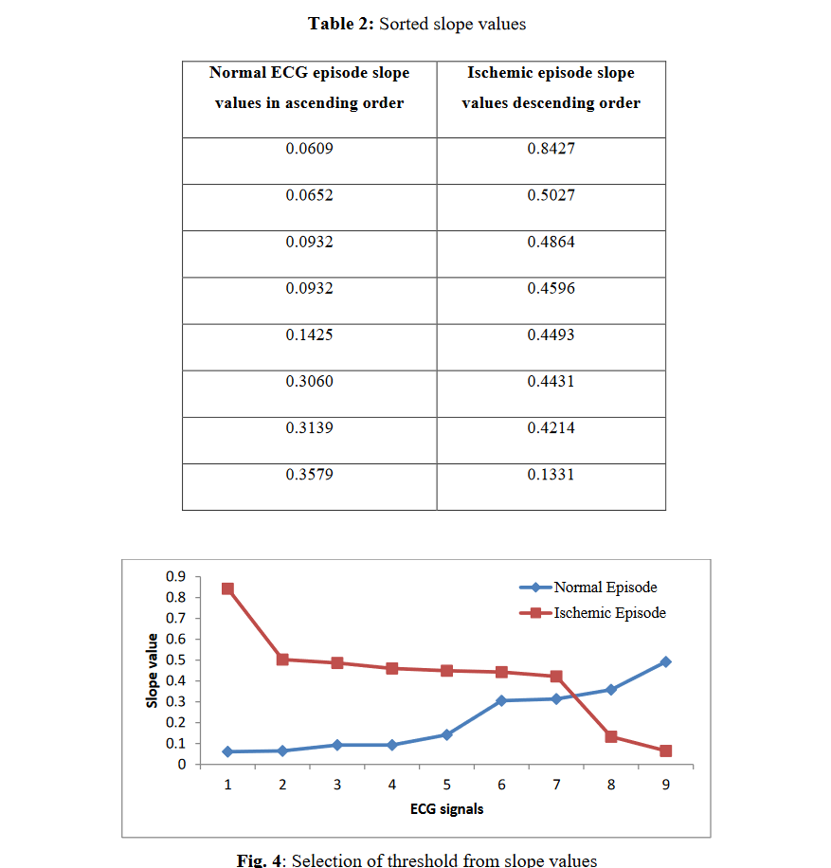
Result of previous work done in ST segment

Slide 24
References
1d Convolutional Neural Network ECG classification(Source: https://www.sciencedirect.com/science/article/pii/S2352914818301333)

Slide 25
Thank you

